Slide 1
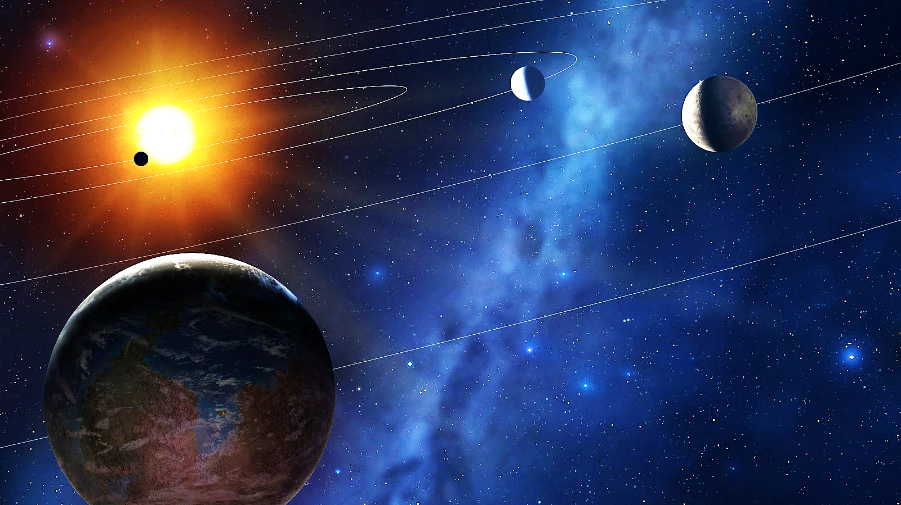

Detecting Exoplanets using Raw Data from NASA’s Kepler Spacecraft
Kaitlin
Puryear

Slide 2
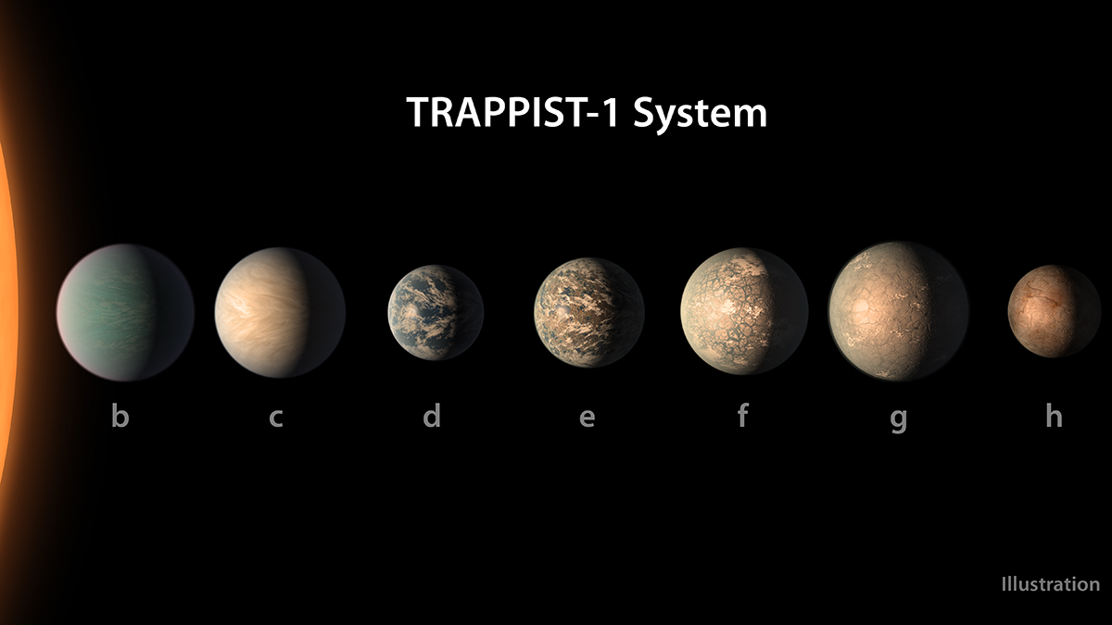
Exoplanet: (noun)
a planet that orbits a star outside our solar system.
ex·o·plan·et, (ˈeksōˌplanət)

Slide 3
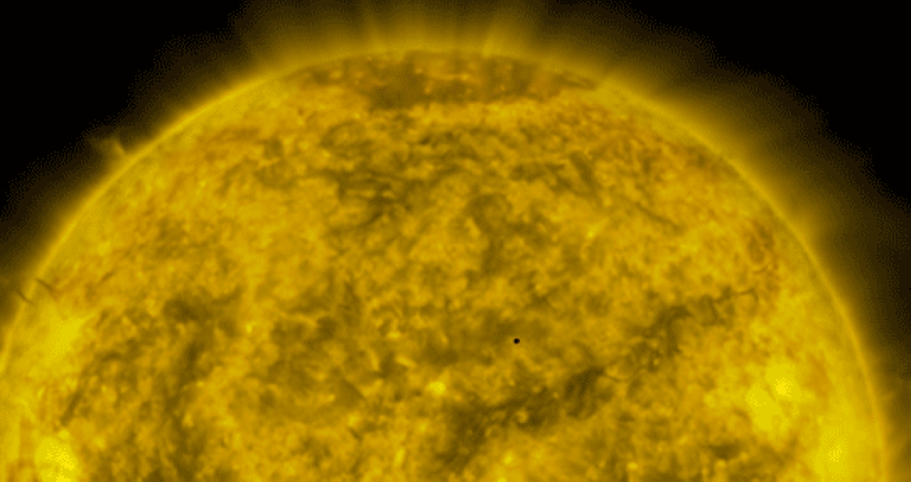
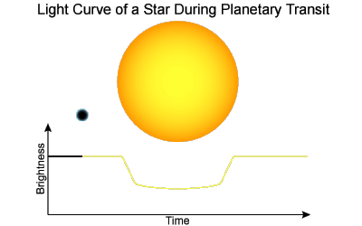
Raw Data: Light Curves

Slide 4
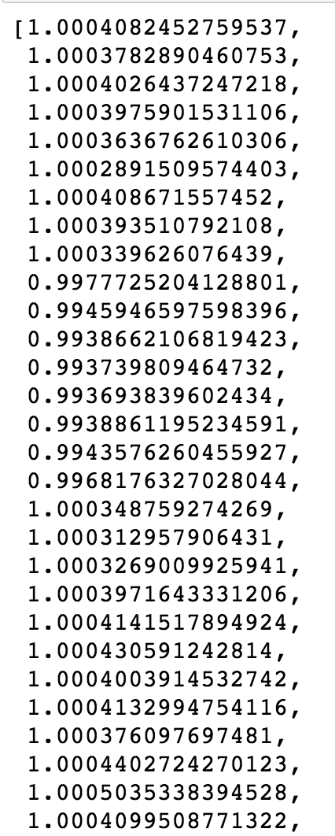

Data Pre-processing Pipeline
.fits file
target pixel file
light curve
pandas dataframe
1D vector
Spoke with some Data Scientists at NASA JPL
Used a package called LightKurve that was created by Kepler GO office

Slide 5
Understanding the Light Curve Data
Normalized Flux:
(Measurement of energy/area)
1626 rows total

Slide 6
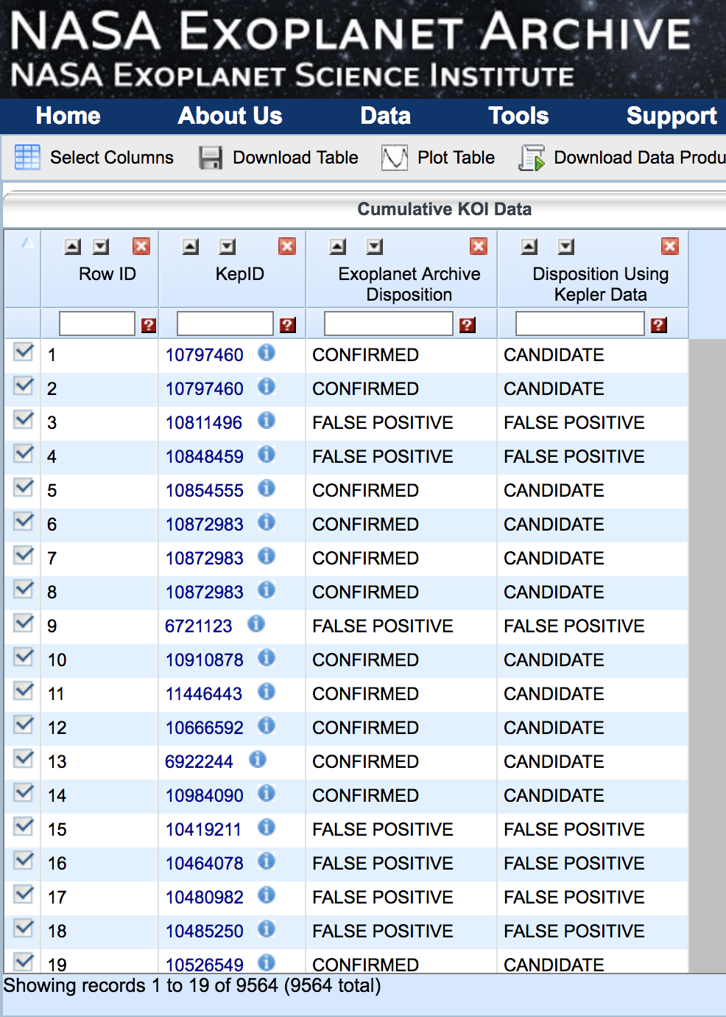
Curate the Data
Labelled Data acquired from NASA Exoplanet Archive.
Match KepIDs, and create the targets for our dataset.

Slide 7
Building a Neural Network for Detecting Planets
Input
(1, 1626) vector of fluxes for the star in question
Output
Classification
- Yes exoplanet
- Not an exoplanet
Artificial
Neural
Network

Slide 8
Building a Neural Network for Detecting Planets
Input Layer
Output Layer
Hidden Layers

Slide 9
Model Performance
My model sucks and is so shameful it can barely call itself a model.
Currently trending at 25% accuracy. Sad Day.
Neural Networks are a pain to optimize.
Need some confusion matrices

Slide 10
Model Performance
My model sucks and is so shameful it can barely call itself a model.
Currently trending at 25% accuracy. Sad Day.
Neural Networks are a pain to optimize.
Anyways, on this slide I want to have some graphs

Slide 11
Conclusions
on this slide I want to make some broad conclusions based on my model.
So far, the conclusion I have is that exoplanets are difficult to predict.
Maybe include some future work.

Slide 12
Thank you! Happy to take questions
Special thanks to NASA’s Kepler Guest Observer Team and the NASA Exoplanet Archive.
Kaitlin Puryear
http://kpuryear.github.io
kaitlinpuryear@gmail.com

Slide 13
Sources
Kepler Guest Observer Office
https://keplerscience.arc.nasa.gov/helpdesk.html
Kepler GO GitHub Repo
https://github.com/KeplerGO/project-ideas
NASA Exoplanet Archive
https://exoplanetarchive.ipac.caltech.edu/
Kepler Telescope Database
https://exoplanetarchive.ipac.caltech.edu/cgi-bin/TblView/nph-tblView?app=ExoTbls&config=koi
LightKurve Docs
http://lightkurve.keplerscience.org/tutorials/quickstart.html
Images
https://www.google.com/search?q=dictionary+exoplanet
https://www.nasa.gov/feature/jpl/new-clues-to-trappist-1-planet-compositions-atmospheres/
https://community.dur.ac.uk/physics.astrolab/exoplanets.html
https://spaceinvader.me/2017/03/02/fourth-planet-from-trappist-added-to-habitable-exoplanet-list

Slide 15
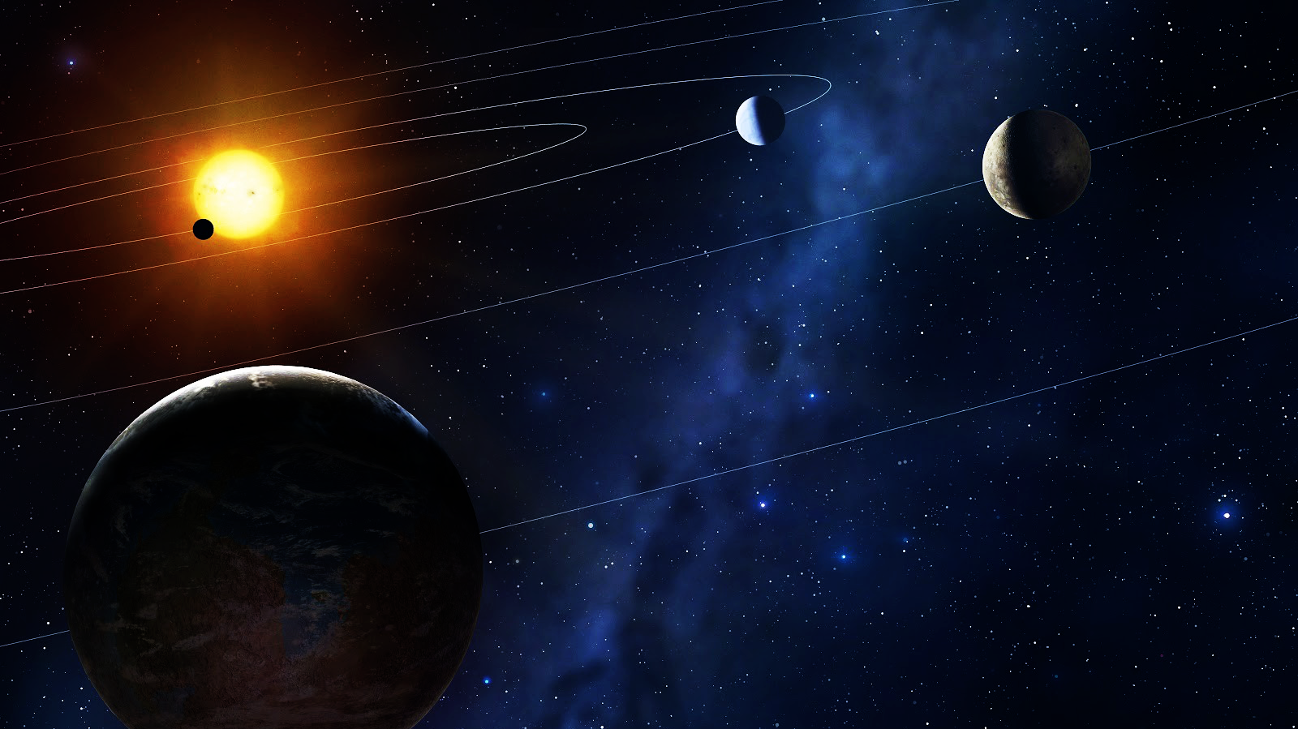
Detecting Exoplanets using Raw Data from NASA’s Kepler Spacecraft
Planets that exist outside our
Solar System
Light Curves from the stars that have planets orbiting them
NASA’s primary exoplanet detection spacecraft

Slide 16
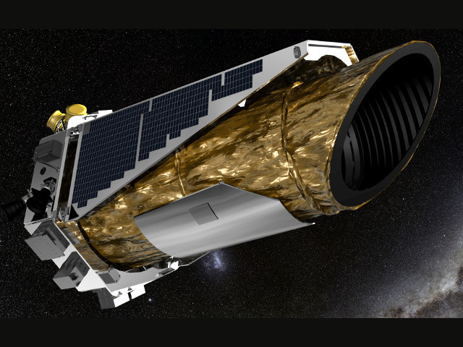
Kepler Spacecraft
Background information
Launched in: from:
Mission objectives:
Discoveries to date:
https://astronomynow.com/2016

